Slide 1
Run Time Environments
Dr. N. Kalyani
Professor, CSE

Slide 2
Run Time Environments
The compiler must cooperate with the operating system and other systems software to support the abstractions on the target machine.
Compiler creates and manages a run-time environment in which it assumes its target programs are being executed.
The environment deals with a variety of issues
The layout and allocation of storage locations for the objects named in the source program
The mechanisms used by the target program to access variables
The linkages between procedures
The mechanisms for passing parameters
The interfaces to the operating system, input/output devices, and other programs.

Slide 3
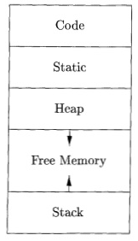
Storage Organization
The execution of target program runs in its own logical address space in which each program value has a location.
The management and organization of this logical address space is shared between the compiler, operating system, and target machine.
The operating system maps the logical addresses into physical addresses, which is spread throughout memory.
The run-time representation of an object program in the logical address space consists of data and program area.

Slide 4
Storage Organization
The storage layout for data objects is strongly influenced by the addressing constraints of the target machine.
Integers may expect integers to be aligned and placed at an address divisible by 4. Although an array of ten characters needs only enough bytes to hold ten characters, a compiler may allocate 12 bytes to get the proper alignment, leaving 2 bytes unused.
The size of the generated target code is fixed at compile time, so the compiler can place the executable target code in a statically determined area Code.
One reason for statically allocating as many data objects as possible is that the addresses of these objects can be compiled into the target code.
To maximize the utilization of space at run time, the other two areas, Stack and Heap, are at the opposite ends of the remainder of the address space.
The stack is used to store data structures called activation records that get generated during procedure calls.

Slide 5
Static Versus Dynamic Storage Allocation
The layout and allocation of data to memory locations in the runtime environment are key issues in storage management.
These issues are tricky because the same name in a program text can refer to multiple locations at run time.
The two adjectives static and dynamic distinguish between compile time and run time, respectively.
Storage-allocation is static, if it can be made by the compiler looking only at the text of the program, not when it executes.
A decision is dynamic if it can be decided only while the program is running.
Many compilers use some combination of the following two strategies for dynamic storage allocation.

Slide 6
Static Versus Dynamic Storage Allocation Cont…
Stack storage : Names local to a procedure are allocated space on a stack.
Heap storage : Data that may outlive the call to the procedure that created it is usually allocated on a "heap" of reusable storage.
The heap is an area of virtual memory that allows objects or other data elements to obtain storage when they are created and to return that storage when they are invalidated.
To support heap management, "garbage collection" enables the run-time system to detect useless data elements and reuse their storage

Slide 7
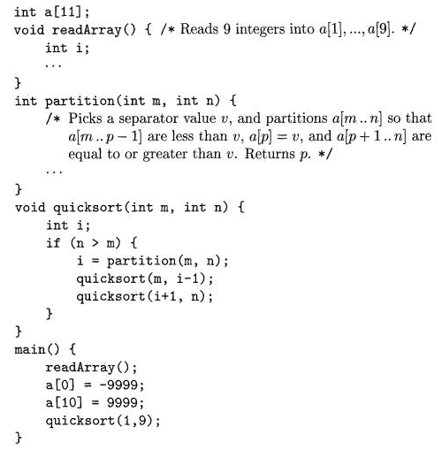
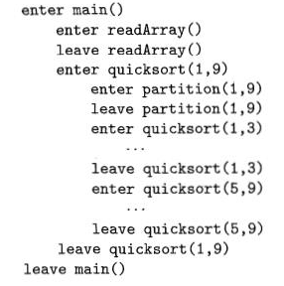
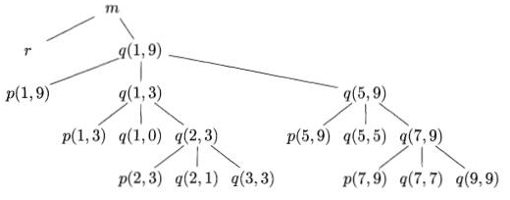
1. Activation Tree
Each time a procedure is called, space for its local variables is pushed onto a stack, and when the procedure terminates, that space is popped off the stack.

Slide 8
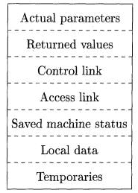
2. Activation Records
Procedure calls and returns are usually managed by a run-time stack called the control stack.
Each live activation has an activation record (sometimes called a frame) on the control stack, with the root of the activation tree at the bottom, and the entire sequence of activation records on the stack corresponding to the path in the activation tree
The actual parameters used by the calling procedure. Commonly, these values are not placed in the activation record but rather in registers, when possible, for greater efficiency.
Space for the return value of the called function, if any. Again, not all called procedures return a value, and if one does, we may prefer to place that value in a register for efficiency.
A control link, pointing to the activation record of the caller.

Slide 9
2. Activation Records
An "access link" may be needed to locate data needed by the called procedure but found elsewhere, e.g., in another activation record.
A saved machine status, with information about the state of the machine just before the call to the procedure.
Return address
The contents of registers of the calling procedure that must be restored when the return occurs.
Local data belonging to the procedure for which the activation record is created.
Temporary values, such as those arising from the evaluation of expressions, in cases where those temporaries cannot be held in registers.

Slide 10
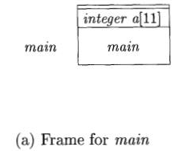
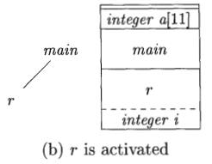
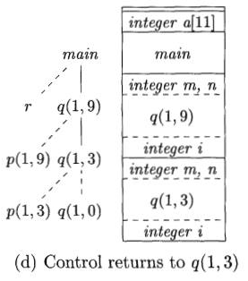
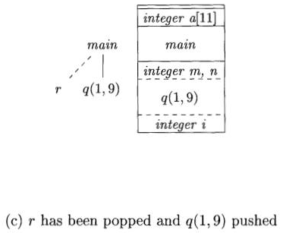
2. Activation Records

Slide 11
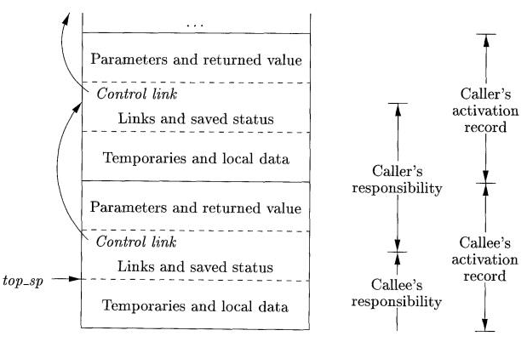
3. Calling Sequences

Slide 12
3. Calling Sequence
When designing calling sequences and the layout of activation records, the following principles are helpful:
Values communicated between caller and callee are generally placed at the beginning of the callee's activation record, so they are as close as possible to the caller's activation record.
It allows for the use of procedures that do not always take the same number or type of arguments, such as C's printf function. The callee knows where to place the return value, relative to its own activation record, while however many arguments are present will appear sequentially below that place on the stack.
Fixed-length items that include the control link, the access link, and the machine status fields are generally placed in the middle. If exactly the same components of the machine status are saved for each call, then the same code can do the saving and restoring for each.

Slide 13
3. Calling Sequence
Items whose size may not be known early enough are placed at the end of the activation record. Most local variables have a fixed length, which can be determined by the compiler by examining the type of the variable. Moreover, the amount of space needed for temporaries usually depends on how successful the code-generation phase is in keeping temporaries in registers.
We must locate the top-of-stack pointer judiciously. A common approach is to have it point to the end of the fixed-length fields in the activation record. Fixed-length data can then be accessed by fixed offsets, known to the intermediate-code generator, relative to the top-of-stack pointer. A consequence of this approach is that variable-length fields in the activation records are actually "above" the top-of-stack. Their offsets need to be calculated at run time, but they too can be accessed from the top-of-stack pointer, by using a positive offset.

Slide 14
3. Calling Sequence
1. The caller evaluates the actual parameters.
The caller stores a return address and the old value of top_sp into the callee's activation record.
The caller then increments top_sp to the top of the position. That is, top_sp is moved past the caller's local data and temporaries and the callee's parameters and status fields.
The callee saves the register values and other status information.
The callee initializes its local data and begins execution.
2. A suitable, corresponding return sequence is:
The callee places the return value next to the parameters.
Using information in the machine-status field, the callee restores top_sp and other registers, and then branches to the return address that the caller placed in the status field.
Although top_sp has been decremented, the caller knows where the return value is, relative to the current value of top_sp; the caller therefore may use that value.

Slide 15
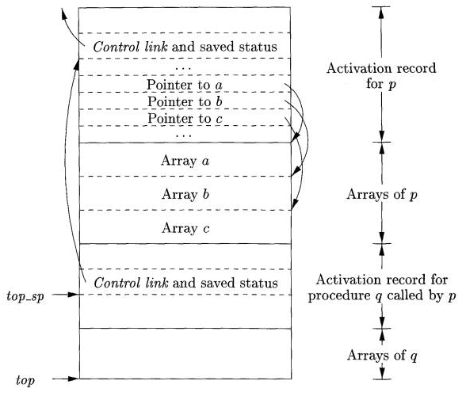
4. Variable-Length Data on the Stack
The caller evaluates the actual parameters.
The caller stores a return address and the old value of top_sp into the callee's activation record.
The caller then increments top_sp to the position. That is, top_sp is moved past the caller's local data and temporaries and the callee's parameters and status fields.

Slide 16
Heap Allocation

Slide 18
Access to Nonlocal Data on the Stack
Data Access Without Nested Procedures :
For languages that do not allow nested procedure declarations, allocation of storage for variables and access to those variables is simple.
Global variables are allocated static storage. The locations of these variables remain fixed and are known at compile time. So to access any variable that is not local to the currently executing procedure, we simply use the statically determined address
2. Any other name must be local to the activation at the top of the stack.
We may access these variables through the top_sp pointer of the stack.

Slide 19
Access to Nonlocal Data on the Stack
Issues With Nested Procedures:
Access becomes far more complicated when a language allows procedure declarations to be nested and also uses the normal static scoping rule; that is, a procedure can access variables of the procedures whose declarations surround its own declaration, following the nested scoping rule described for blocks in Section 1.6.3. The reason is that knowing at compile time that the declaration of p is immediately nested within q does not tell us the relative positions of their activation records at run time. In fact, since either p or q or both may be recursive, there may be several activation records of p and/or q on the stack.
Finding the declaration that applies to a nonlocal name x in a nested pro-cedure p is a static decision; it can be done by an extension of the static-scope rule for blocks. Suppose x is declared in the enclosing procedure q. Finding the relevant activation of q from an activation of p is a dynamic decision; it re-quires additional run-time information about activations. One possible solution to this problem is to use "access links," which we introduce in Section 7.3.5.

Slide 20
Access to Nonlocal Data on the Stack
A Language With Nested Procedure Declarations:
ML is a functional language, meaning that variables, once declared and initialized, are not changed. There are only a few exceptions, such as the array, whose elements can be changed by special function calls.
• Variables are defined, and have their unchangeable values initialized, by a statement of the form:
val (name) = (expression)
• Functions are defined using the syntax:
fun (name) ( (arguments) ) = (body)
• For function bodies we shall use let-statements of the form:
let (list of definitions) in (statements) end The definitions are normally v a l or fun statements. The scope of each such definition consists of all following definitions, up to the in, and all the statements up to the end.

Slide 21
Access to Nonlocal Data on the Stack
Access Links :
Access becomes far more complicated when a language allows procedure declarations to be nested and also uses the normal static scoping rule; that is, a procedure can access variables of the procedures whose declarations surround its own declaration, following the nested scoping rule described for blocks in Section 1.6.3. The reason is that knowing at compile time that the declaration of p is immediately nested within q does not tell us the relative positions of their activation records at run time. In fact, since either p or q or both may be recursive, there may be several activation records of p and/or q on the stack.

Slide 22
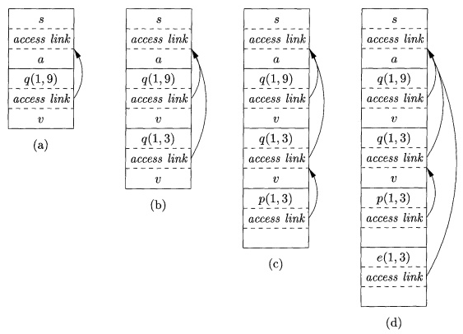
Access to Nonlocal Data on the Stack
Access Links :

Slide 23
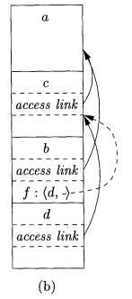
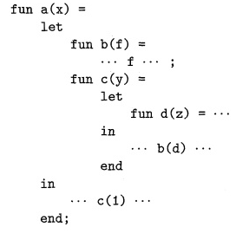
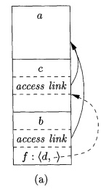
Access to Nonlocal Data on the Stack
Access Links for Procedure Parameters:

Slide 24
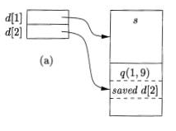
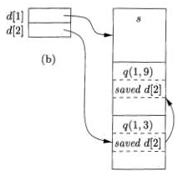
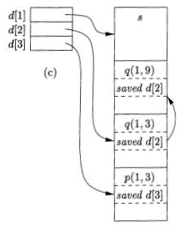
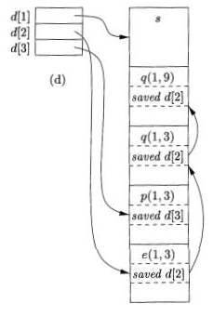
Access to Nonlocal Data on the Stack
Displays:

Slide 25
Heap Management
The Memory Manager:
• Allocation. When a program requests memory for a variable or object,3 the memory manager produces a chunk of contiguous heap memory of the requested size. If possible, it satisfies an allocation request using free space in the heap; if no chunk of the needed size is available, it seeks to increase the heap storage space by getting consecutive bytes of virtual memory from the operating system. If space is exhausted, the memory manager passes that information back to the application program.
• Deallocation. The memory manager returns deallocated space to the pool of free space, so it can reuse the space to satisfy other allocation requests. Memory managers typically do not return memory to the operating sys-tem, even if the program's heap usage drops.
Here are the properties we desire of memory managers:
• Space Efficiency. A memory manager should minimize the total heap space needed by a program. Doing so allows larger programs to run in a fixed virtual address space. Space efficiency is achieved by minimizing "fragmentation," discussed in Section 7.4.4.
• Program Efficiency. A memory manager should make good use of the memory subsystem to allow programs to run faster. As we shall see in Section 7.4.2, the time taken to execute an instruction can vary widely depending on where objects are placed in memory. Fortunately, programs tend to exhibit "locality," a phenomenon discussed in Section 7.4.3, which refers to the nonrandom clustered way in which typical programs access memory. By attention to the placement of objects in memory, the memory manager can make better use of space and, hopefully, make the program run faster.
• Low Overhead. Because memory allocations and deallocations are fre-quent operations in many programs, it is important that these operations be as efficient as possible. That is, we wish to minimize the overhead — the fraction of execution time spent performing allocation and dealloca-tion. Notice that the cost of allocations is dominated by small requests; the overhead of managing large objects is less important, because it usu-ally can be amortized over a larger amount of computation.

Slide 26
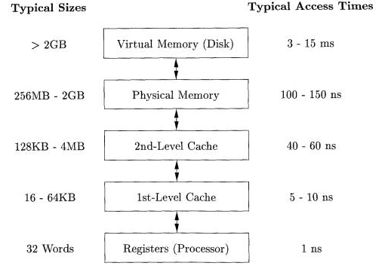
Heap Management
The Memory Hierarchy of a Computer:

Slide 27
Heap Management
Locality in Programs
The typical program spends most of its time executing innermost loops and tight recursive cycles in a program.
Locality allows us to take advantage of the memory hierarchy of a modern computer, as shown in Fig. 7.16. By placing the most common instructions and data in the fast-but-small storage, while leaving the rest in the slow-but-large storage, we can lower the average memory-access time of a program significantly.
Reducing Fragmentation
First Fit
Best Fit
Worst Fit

